Slide 1
Multimedia Databases
Arif Ghafoor
Professor
Electrical and Computer Engineering
Purdue University

Slide 2
Multimedia Database Laboratory Facilities at Purdue University
Distributed Multimedia Systems Lab (ECE)
  Ghafoor, Kashyap, Khan
Multimedia Systems Lab (CS)
  Aref, Elmagarmid, Prabhakar
Raid Lab (CS)
  Bhargava
Video and Image Processing Lab (ECE)
  Delp

Slide 3
On-Going Research Projects in Multimedia Databases
Multimedia database management
(NSF, Fuji Electric, AT&T)
  Video modeling and management
  Multimedia document management
Distributed multimedia systems
(NSF, AFRL, IBM, Intel, Siemens)
High-performance multimedia database architecture for storage management
(NSF, AT&T)

Slide 4
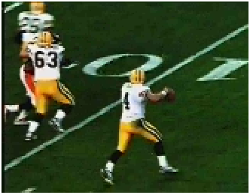
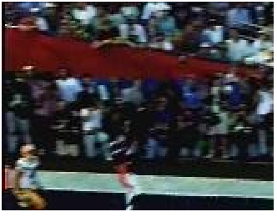
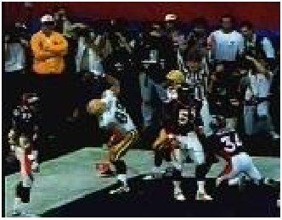
Example of Event-Based Video Data (Touch-down Scenario)

Slide 5
Research Challenges for Video Databases
Development of video processing techniques for automatic object identification and motion tracking
Development of data models with powerful semantic expressiveness
Designing efficient indexing, classification and event-based searching techniques with high degree of precision
Providing suitable video querying environment
Addressing scalability

Slide 6
Semantic Video Data Modeling Complexity
High
Knowledge-based
Higher-level
Semantics
Iconic-based
Grouping and
Browsing
Motion Detection
Analysis
Level of Abstraction
Video Parsing and
Segmentation
Object Recognition
Low
Coarse
Granularity
Fine

Slide 7
An Architecture for Video Database System
Spatio-Temporal Semantics:
Formal Specification of
Event/Activity/Episode for
Content-Based Retrieval
Object Definitions
(Events/Concepts)
Inter-Object Movement
(Analysis)
Intra/Inter-Frame
Analysis
(Motion Analysis)
Spatial-Semantics
of Objects
(human,building,…)
Semantic Association
(President, Capitol,...)
Object Identification
and Tracking
Physical
Object
Database
Image Features
Sequence of Frames
(indexed)
Object Description
Raw
Image
Database
Temporal
Abstraction
Raw
Video
Database
Frame
Spatial Abstraction

Slide 8
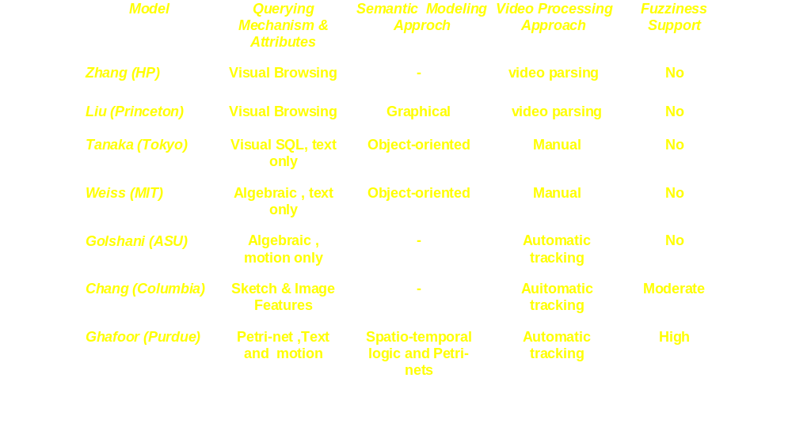
Comparison of Different Video Database Management Projects

Slide 9
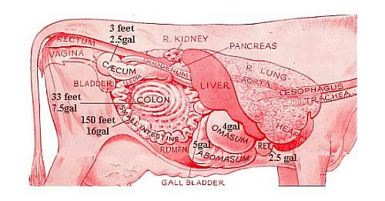
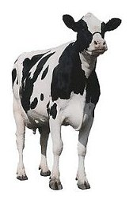
Sample Multimedia Document
Exit
The Ruminant Digestive System
Four compartment stomach that:
- utilizes complex carbohydrates
such as cellulose
- utilizes non-protein nitrogen
sources
- utilizes feeds of no nutritive value
for humans
Rumen
The rumen, the first compartment of the ruminant stomach, is essentially non-functional at birth but develops rapidly when calves are given solid feeds such as hay and grain.
Abomasum
Omasum
Reticulum
Esophagus
Protozoa
Rumen
Digestive System
Stomach
Small Intestine
Salivary Glands
Large Intestine
Multimedia Browsing Graph

Slide 10
Document Representation and Specification Complexity
Media Types and Attributes Complexity
HyTime
SGML/XML
Style Complexity
MPEG
Word
Interleaf/
PDF
Framemaker
VRML
HTML
Structure Complexity

Slide 11
- End-to-End
Delays
- Jitter Delay
- Bandwidth
- Packet Loss
Rate
End-to-End QoP / QoS Management
- Reliability
- Resolution
- Rate of Presentation
- Display Area
- Temporal Synchronization ( Intra/Inter )
Specification
Meta Data / User Interface
Translation
Network
OS
Database
Security
- CPU Throughput
- Memory Overflow
and Reliability
- Storage Throughput/
Bandwidth
- Storage Delays
- Distributed
Database
Coordination (QoS)
- Intrusion Detection
- Access Control
Negotiation
Dependency Model Analysis and QoS Adjustment
End-to-End
Run Time
Scheduling
End-to-End Resource Allocation and Scheduling

Slide 12
Multimedia Document Management
Quality of presentation requirements
  Resolution, reliability, rate
Synchronization requirements
  Temporal, spatial, and logical structure specification
Media processing requirements
  Coloring, enhancements, dubbing, etc.
Security attributes

Slide 13
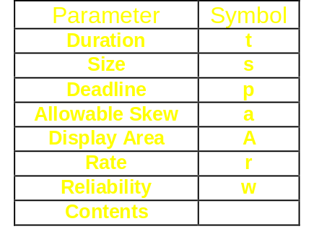
Petri-Net Based Model for Synchronization and Quality Specification of Multimedia Documents
Text
Text
Video
Video
Image
Audio
Audio
π
π
π
π
1
2
3
4

Slide 14
Multimedia Browsing Environment
Abomasum
Omasum
Esophagus
Reticulum
Protozoa
Rumen
Stomach
Text
Digestive System
Audio
Text
Image
Small Intestine
Image
Text
Salivary Glands
Text
Video
Large Intestine
Audio
Image

Slide 15
Research Issues for Quality and Performance of Multimedia Document Management Systems
Document modeling (Dimensionality/Flexibility/Portability)
  Languages (SGML/XML)
  Graphical (OCPN)
Transformation among models and heterogeneity management of models
Development of efficient search and indexing techniques for multimedia documents using these models
Clustering of documents
  Based on contents for fast search
  Controlled access

Slide 16
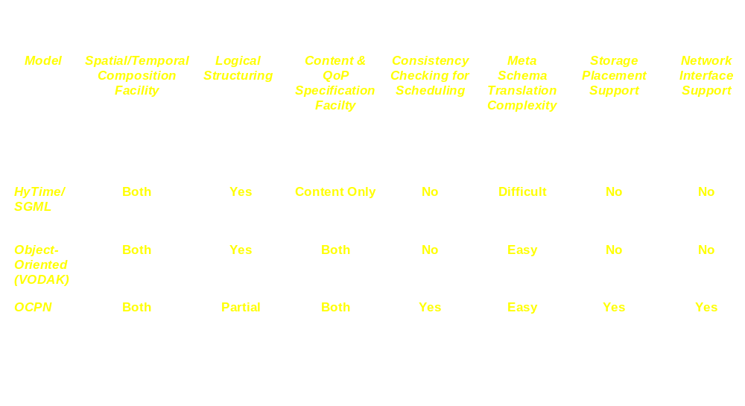
Comparison of Different Multimedia Document Models

Slide 17
Software Architecture of a Multimedia Database Management System
User
To Presentation Device
Multimedia
Structuring Module
Document Generator
Tool Library
HyTime/SGML/XML Translator
Multimedia Meta-Data
HyTime/SGMLXML Parser --> Multimedia Query Language
OODBMS and MQL
Distributed Query Processor
Temporal Synchronization Manager
Text
Database
Video
Database
Image
Database
Audio
Database

Slide 18


Distributed Multimedia Database Systems
DBMS
Audio
DBMS
Image
Presentation Device
DBMS
Audio
Network A
Network B
DBMS
Audio
DBMS
Video
DBMS
Text

Slide 19
Research Issues in Distributed Multimedia Database Management
Distributed Object Management
Efficient distributed query processing techniques
Network caching techniques for composition of distributed objects
Adaptive data filtering techniques to satisfy diverse user QoS requirements

Slide 20
Architecture of a Distributed Multimedia Database Management
Multimedia Database Client
Visual Tool for
Multimedia Document
Generation
Multimedia
Database Interface
Multimedia
Presentation Subsystem
API for SBS Network
Integrated Multimedia Information Server
API for SBS Network
Distributed Query
Processor
Multimedia Database Server
Multimedia Meta Data
Management
Directory
Management
Meta
Data
Database
Management
System
Media Server
Subsystem
API for SBS Network
...
Database Connectivity
Multimedia
Database Server
Multimedia
Database Server
Text
Image
Video
Audio

Slide 21
Planned Experiments
Development of video database management system ( using database compute servers and storage system)
Development of multimedia document management system
Development of distributed multimedia object management system using SBS architecture

